Slide 1
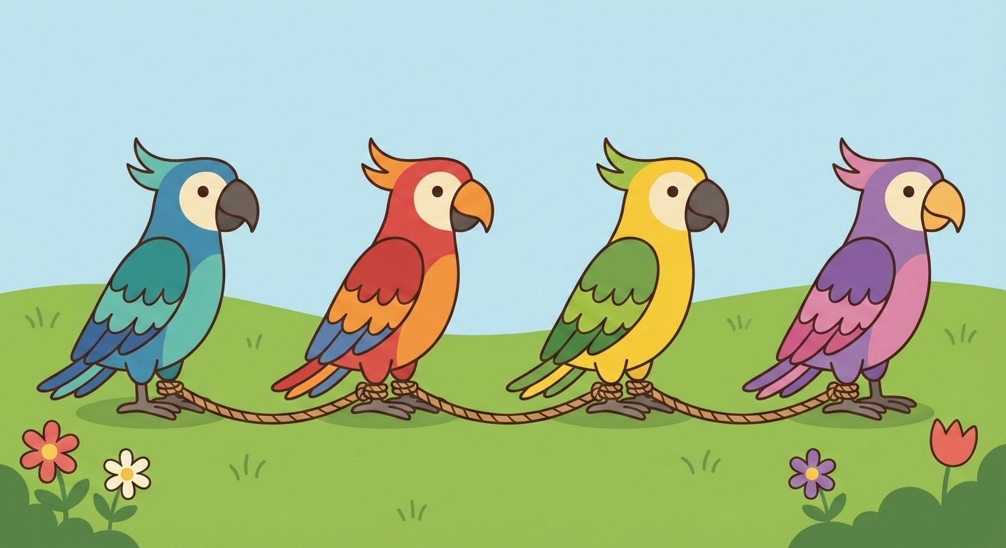

Agentic AI with LangChain and LangGraph
Presentation 5: Some Advanced Topics of LangChain
Primary Instructor: Michael Z
RA: YH
Date: 2026.Jan-Feb

Slide 2
*Quick Notes:
I would skip some topics for some reasons: Long-Term memory (current technique is not mature) and Multi-agent (Because it belongs to our next topic, LangGraph) and Context Engineering (It looks like philosophy of being AI engineer, rather than a topic of technique).
I would place different weights on different sections.
I mean, it could take me a 3-credit course to go over RAG (Retrieval Augmented Generation), but I only have couple mins to talk about it here. Thank you for your understanding in advance.
LangChain Inc is maintaining v0.3+ and v1.0+.

Slide 3
0. RAG

Slide 4
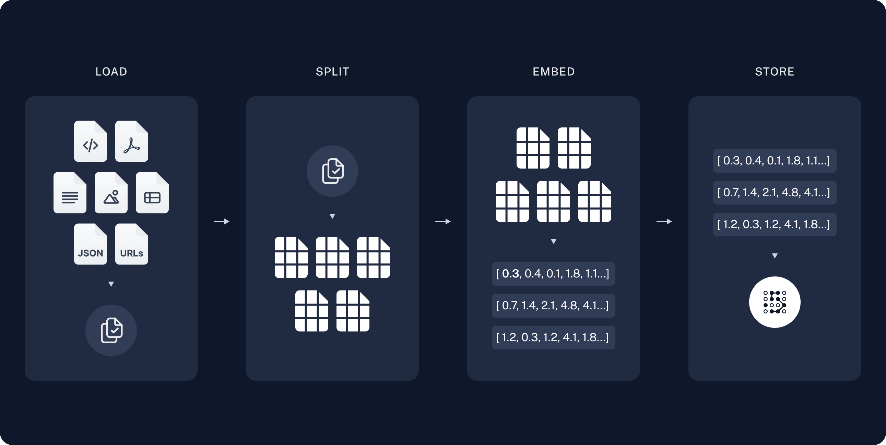
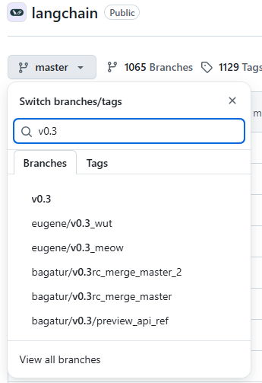
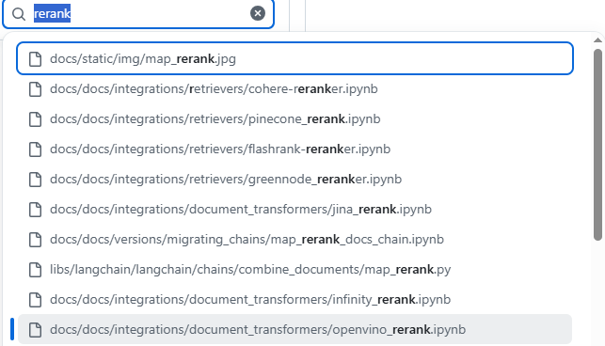
0. RAG: Core Idea
The core idea of RAG can’t be easier:
1.Documents Loading (Serialization)
2.Documents Splitting (also known as Chunking Strategy in some framework)
3.(Chunks) Embedding
4.Storing
5.Semantic Search for given query
6.Top K Records retrieved
7. Reranking (Optional)
8. Sent to LLM context for augmented generation
The image RHS covers 1-4.
1-7 is R and 8 is G.
If you are interested in any of the steps mentioned above, raise your hands to ask me right now or google it on your own.
Current docs provided by LangChain didn’t explain Reranking very well so you might go to its v0.3 to read archived docs in GitHub.

Slide 5
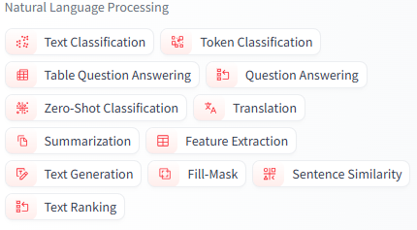
*Quick Note Again……
When you are playing with RAG and try to choose the embedding model you like from HuggingFace, you might notice that there doesn’t actually exist a section called “Embedding Model”.
It’s actually called “sentence similarity”, which is a little bit weird but also comprehensible.

Slide 6
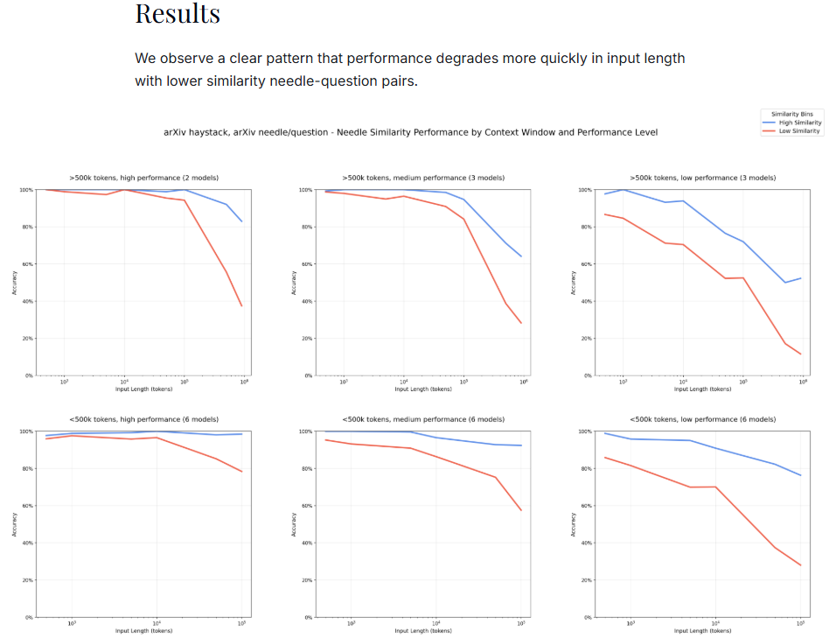
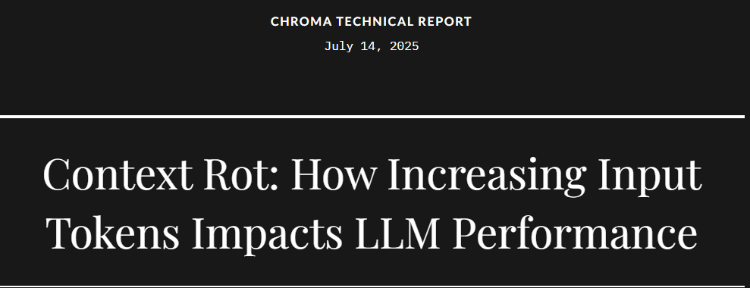
0. RAG: RAG is dead……But you still need to learn!
Source: https://research.trychroma.com/context-rot

Slide 7
0. RAG: RAG in LangChain Docs
1.Vanilla RAG
2.Hybrid RAG
3.Rerank-based RAG
4.Query Expansion RAG
5.Multi-Hop RAG
6.Graph RAG
7.Adaptive RAG
8.Agentic RAG
……….
All, I mean all, variants of RAG you can see right now or in the future implement the core idea I discussed in previous slides, with
a little
a little
a little
a little
a little
a little
a little
a little
bit of engineering design added.

Slide 8
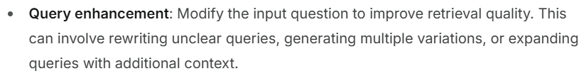


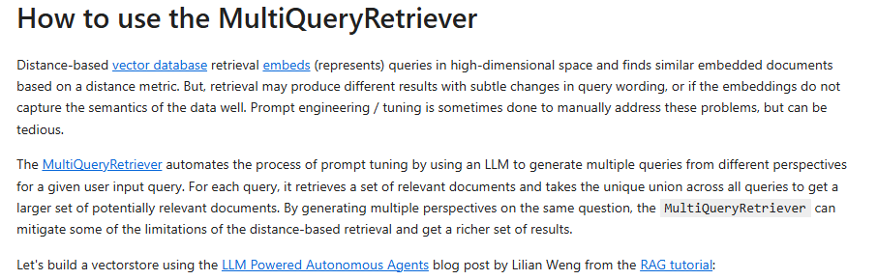
*Fun Fact
When reading the LangChain docs (Hybrid RAG), I noticed the following, which reminds me of something.
Aha!!!
It turns out that it’s actually MultiQueryRetriever (in v0.3 of LangChain)

Slide 9
1. Human-In-The-Loop (HITL)

Slide 10
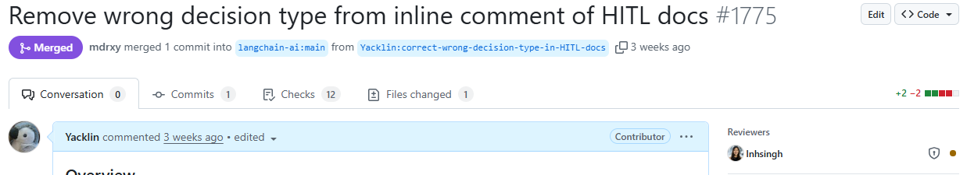
1. HITL
HITL is commonly used in multi-agent system, but I think it’s also good to know that it could be used in single agent application.
HITL basically means that you impose some restrictions on some tools and agent needs your explicit approval when it’s about to call these tools.
(If you don’t understand “allowed decisions” in their documents, replace “allowed” with “available” simply.)
I would go over HITL docs for you right now.
To make sure you are learning correct documents, I corrected one wrong inline comment for you.

Slide 11
1. HITL: If you are good at using HITL…..
Those who are proud of being part of something or good at using something or loving something would call themselves “…..er”.
For example, those who are good at singing would call themselves “singer”.
If you are good at playing games, you might call yourself “gamer”.
If you are good at using HITL..
HITL + ER = ….
😨😨😨😨

Slide 12
2. MCP

Slide 13
*async and await keywords in Python
https://docs.python.org/3/library/asyncio-task.html

Slide 14
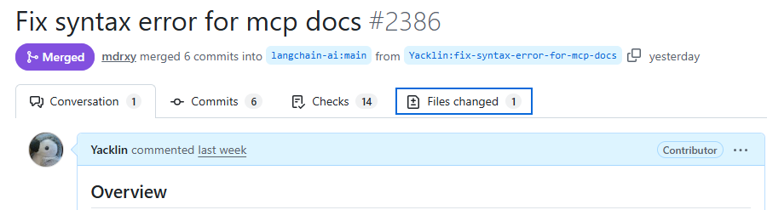
2. MCP: They finally accepted my fix!!!!!
I noticed some syntax errors in their docs when preparing slides last week, so I made a PR to fix it. But they didn’t accept my fix until Thursday (Feb 5th). I believe the code snippet is quite copy-and-paste-able.

Slide 15
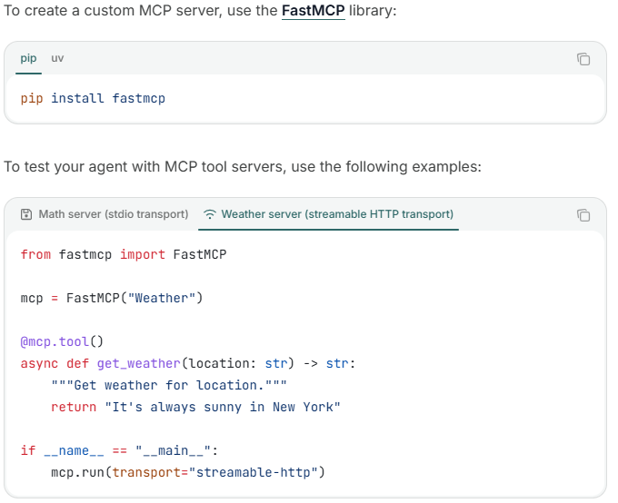
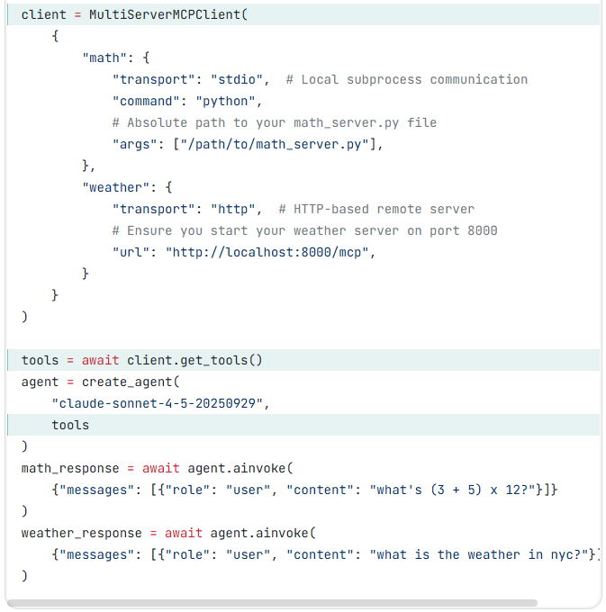
2. MCP
You make the tools in the Python script in which agent is about to be invoked, before we talk about MCP today.
If there is a lot of tools and tool’s implementation is complex, you might want to move these tools to somewhere else.
You also would like to allow others to use the tools you made.
Then, MCP is your best choice. You put tools in a single script and deploy this script as a http server (aka MCP server and its default port is 8000).
At client side, just simply call these tools gracefully.

Slide 16
*A Quick In-Presentation Practice Here

Slide 17
3. Runtime (Context)

Slide 18
3. Runtime (Context)
There are two parts in Runtime: Context and Store (skipped)
Context can be treated as user structured input, to help you understand it better.

Slide 19
4. Guardrails

Slide 20
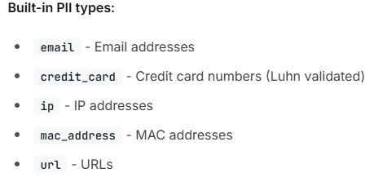
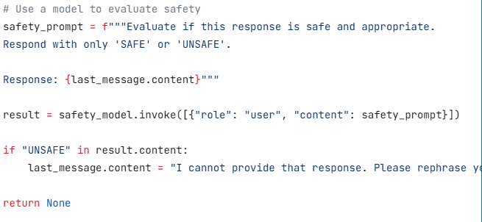
4. Guardrails: PII
There are two ways to achieve guardrails: One is HITP and another is PII detection.
What guardrails can do is screening, like what could not be visible to LLM and what could be visible to user. I mean because of middleware, you can basically control visibility of every single message, literally.
We already discussed HITP so I would only talk about PII here.
PII means personally identifiable information.
Here is a very quick in-class test and I want you to finish it:
LangChain-provided example is not that good. Can you refine it for them? How? (hint: to make LLM generate something you need…..)

Slide 21
*I would take a couple questions here

Slide 22
5. Hands-On Project…..Again….

Slide 23
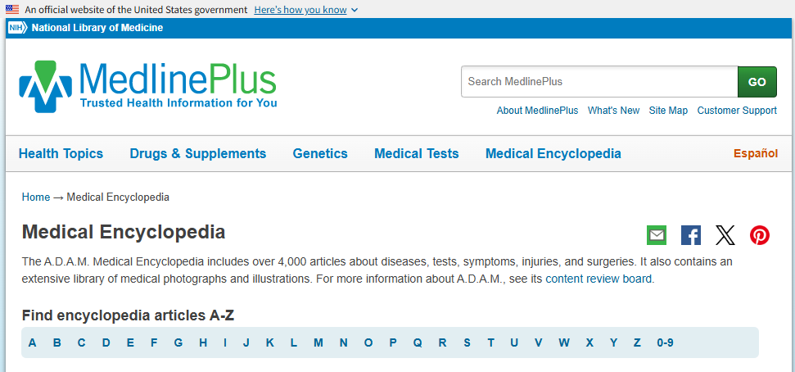
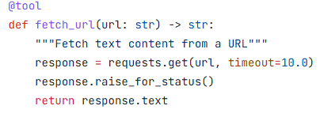
5. Hands-On Project: Agentic RAG vs Vanilla RAG
I believe most of you have used/built RAG-enabled applications before. Probably it’s low-code or no-code. But this time I am curious if well-designed Agentic RAG could outperform Vanilla RAG.
Project Description: Build RAG AND Agentic RAG (which means two PROGRAMS) using the following website as external source of information and then compare quality of responses generated by these two approaches.
When user asks a healthcare related question, your Python programs, I mean both, should be able to retrieve relevant information from the website first, send it to Agent (or LLM) and then the Agent (or LLM) would respond to user with augmented response.
PLEASE DON’T SIMPLY SEND ALL OF WHAT IS RETRIEVED TO LLM/AGENT! USING TOKENS INEFFICIENTLY WOULD ONLY MAKE YOU RUN OUT OF 2-USD BUDGET!!!!!!!!!!! ADD SOME FILTERS PLEASE!!!!!!

Slide 24
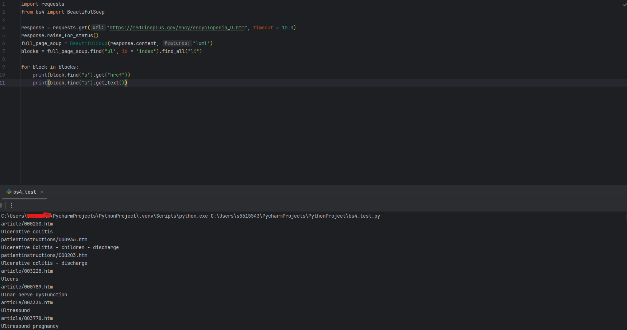
5. Hands-On Project: A possibly helpful starter
Use bs4 to extract html content given a link.
Just simply: uv add bs4
uv add lxml to use lxml as feature.
Different page might or might not have the same html structure, so please click “inspect” to view the structure in the webpage.
I wont’ be able to teach bs4.

Slide 25
5. Hands-On Project: How to Compare? (Evaluation)
If user asks a question like “what should I do if I have bipolar disorder and insomnia?”, a good RAG should retrieve both information related to bipolar disorder and information related to insomnia.
In other words, the more relevant information gets retrieved, the better the RAG is. This is how we, and most of researchers, evaluate RAG.
To make my life easier, please use print function to print what’s retrieved from website for each RAG.

Slide 26

Thank you for your paged attention!

Slide 27


